Slide 1

Lesson 1
Nada Shaath
الطعام الصحي
This lesson was adapted from a unit developed by LA Startalk Team
This lesson was developed by using funds from QFI (Qatar Foundation International)

Slide 2
Watch the video on the screen and write three things you think this video is presenting.

Slide 3
Watch the video and write at least three things you think this video is presenting?
2
1
3
Notes:
Created by

Slide 4
Vocabulary

Slide 5
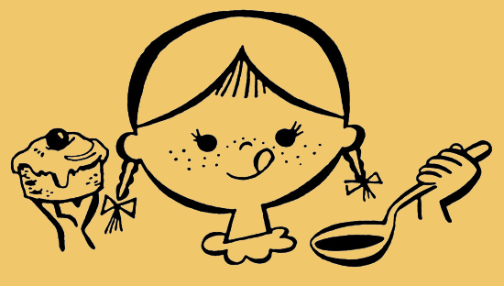
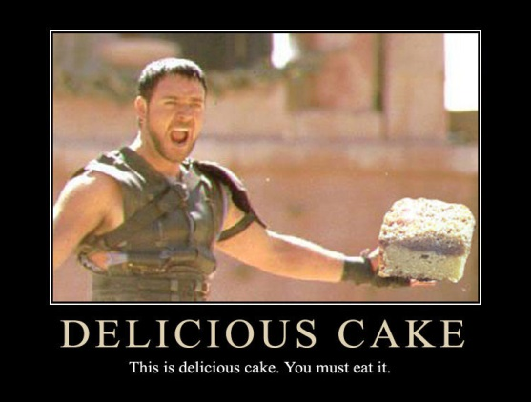
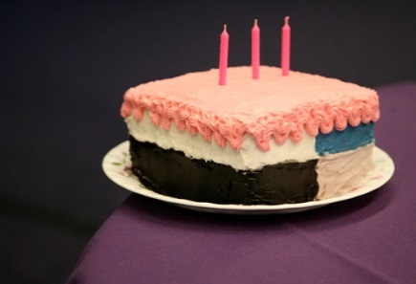
لذيذ

Slide 6


برنامج تلفزيوني

Slide 7
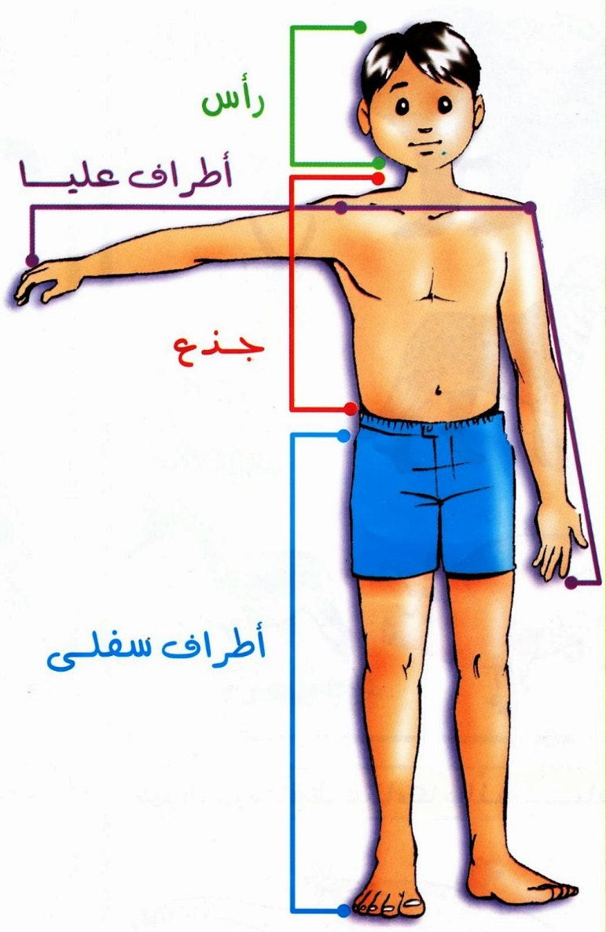
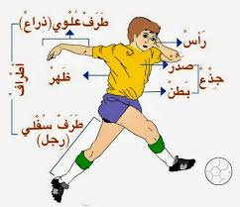
جسم

Slide 8
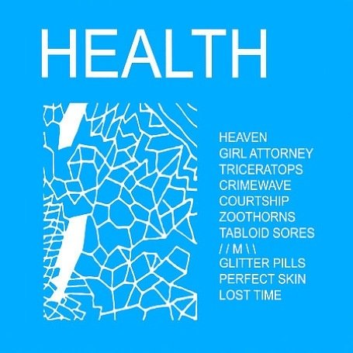
صحة

Slide 9
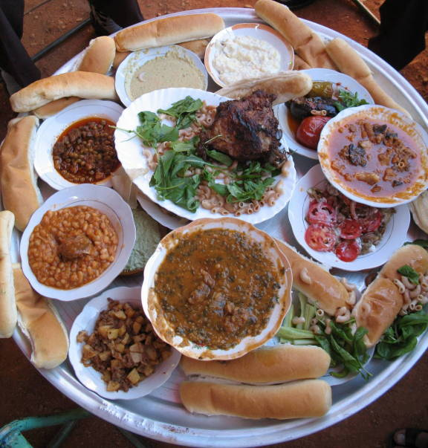
مائدة / طاولة

Slide 10
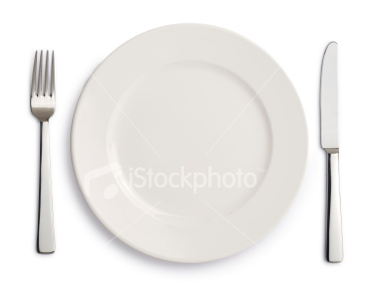
طبق

Slide 11
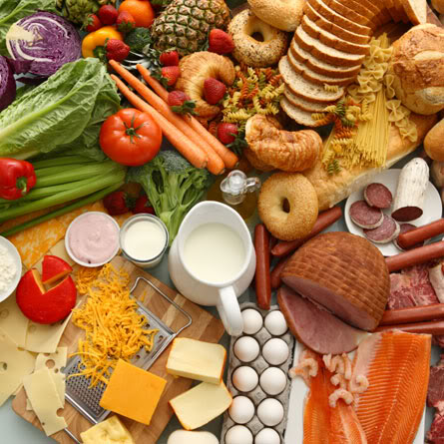
الغذاء

Slide 12
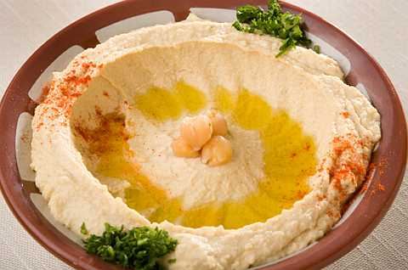
حمص

Slide 13
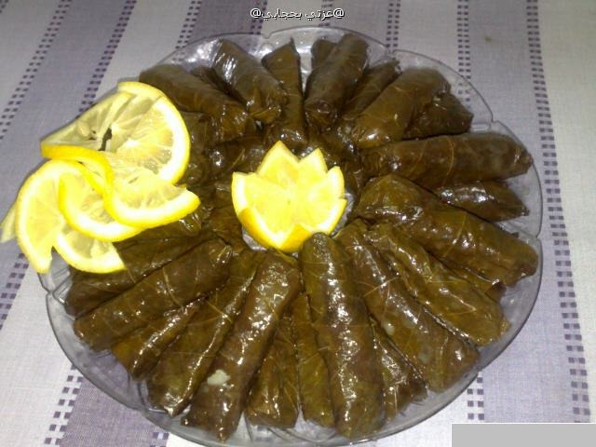
ورق عنب

Slide 14
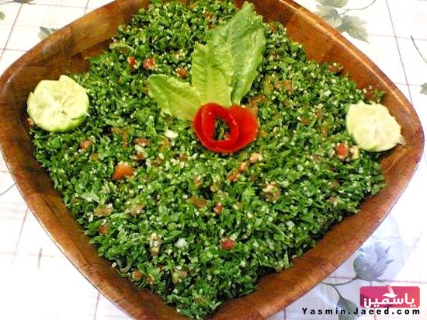
تبولة

Slide 15
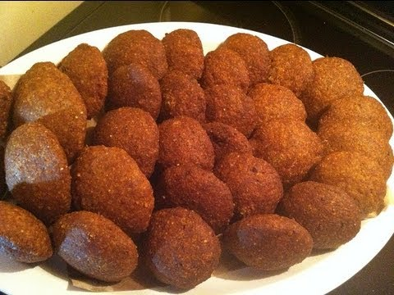
كبة

Slide 16
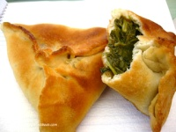
فطاير سبانخ

Slide 17
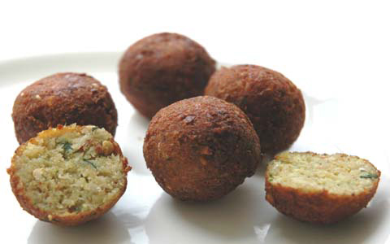
فلافل

Slide 18
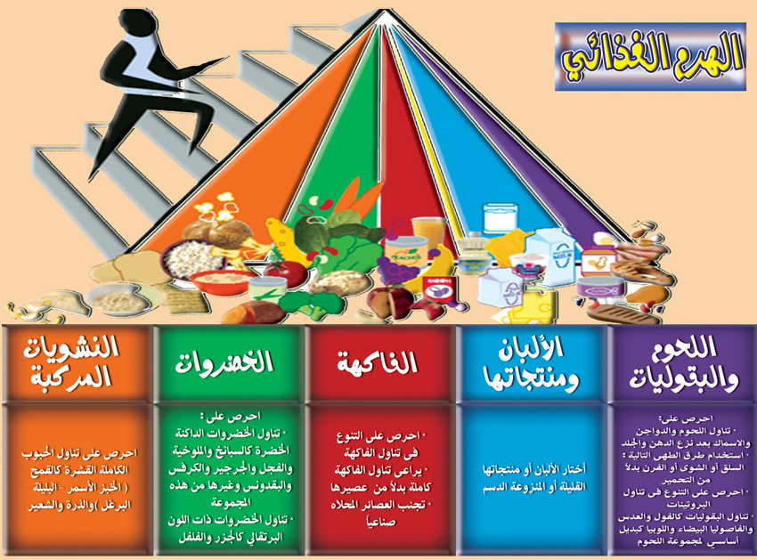

Slide 19
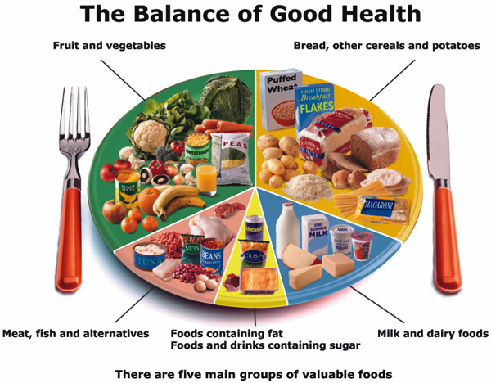

Slide 20
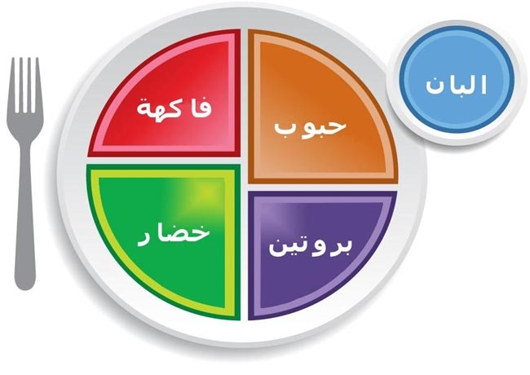

Slide 21
Food category
As you know food we eat belong to different categories on a pyramid called (food Pyramid) الهرم الغذائي .
Food pyramid contains
Carbohydrates كربوهيدرات
Vitamins فيتامينات
Proteins بروتينات
Oils دهنيات

Slide 22
To be healthy you must eat the right amount of food from different categories, exercise, and drink ماء

